Slide 1


Leaders Containers Trading FZE
WE SEE YOUR DREAMS
WE ARE ALL ABOUT CONTAINERS

Slide 2
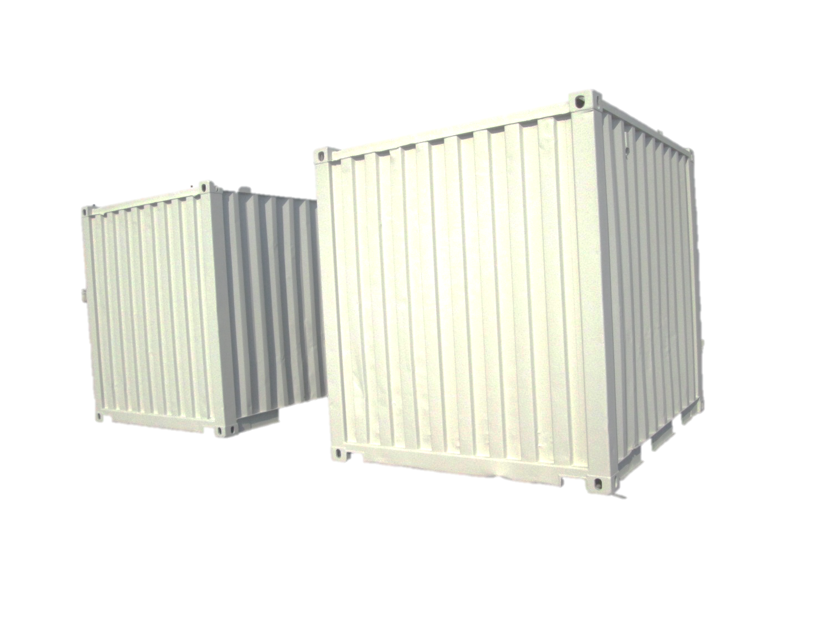
10’ DRY CONTAINERS FOR ADMA/ZADCO/DP STANDARD
10FT X 8FT X 8FT 6 INCH HIGH
CORTEN STEEL BODY
ISO CASTING
PADEYE FOR LIFTING WITH SLING/SHACKLES
Leaders Containers Trading FZE

Slide 3
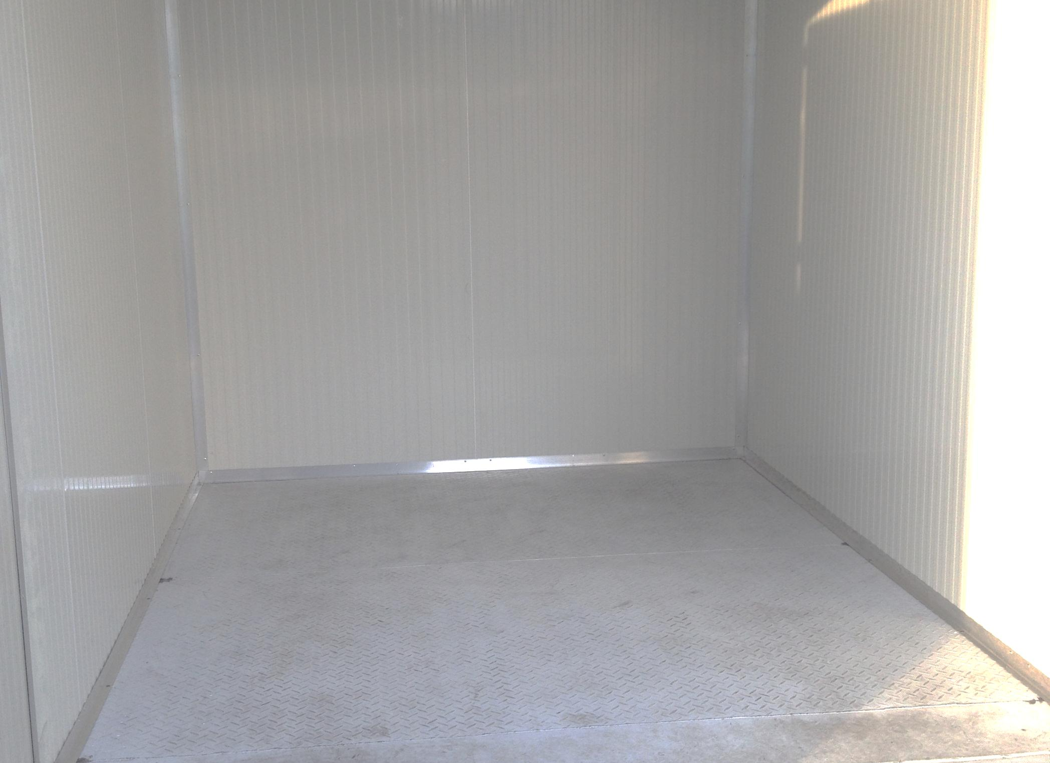
INTERNAL CONTAINER DIMENSION | 10’ STANDARD CONTAINER
CONTAINER LENGTH | 2.80 m
CONTAINER WIDTH | 2.33
CONTAINER HEIGHT | 2.35
INSULATION USED BY 50MM PU WITH GI SHEET EXTERIOR
TO BE LINED WITH POLYURETHANE INSULATED SANDWICH PANELS
50MM THICKNESS WITH A DENSITY OF 37-39 KG/M3
TOP AND BOTTOM SKIN 0.5MM, GALVANIZED STEEL COATED WITH POLYSTER RAL 9002
CORNERS TO BE SECURED WITH ALUMINUM ANGLE WITH MILL FINISH OR POWDER COATED DECIDED BY CLIENT
Leaders Containers Trading FZE

Slide 4
INTERNAL CONTAINER DIMENSION | 20’ STANDARD CONTAINER
CONTAINER LENGTH | 6.06 m
CONTAINER WIDTH | 2.33
CONTAINER HEIGHT | 2.35
INSULATION USED BY 50MM PU WITH GI SHEET EXTERIOR
TO BE LINED WITH POLYURETHANE INSULATED SANDWICH PANELS
50MM THICKNESS WITH A DENSITY OF 37-39 KG/M3
TOP AND BOTTOM SKIN 0.5MM, GALVANIZED STEEL COATED WITH POLYSTER RAL 9002
CORNERS TO BE SECURED WITH ALUMINUM ANGLE WITH MILL FINISH OR POWDER COATED DECIDED BY CLIENT
Leaders Containers Trading FZE

Slide 5
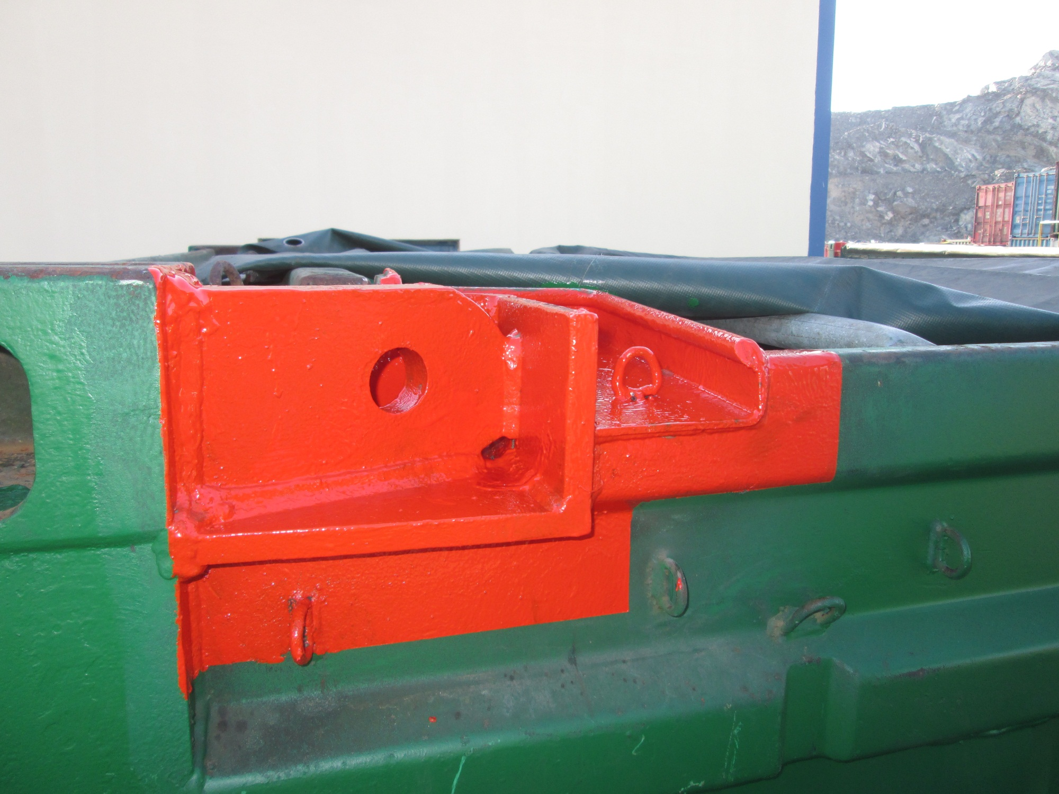
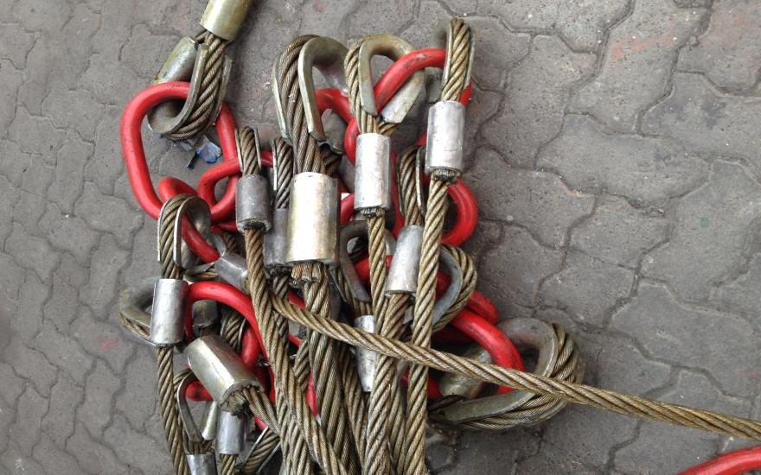
PAD EYE MEASUREMENT
SIZE:- 200mm X 110 mm
THICKNESS:- 25 mm
HOLE SIZE:- 37mm
PAD EYE BASE PLATE:- 250X250X14mm
SIDE PLATE:-250X110X14mm
PAD EYE WITHOUT REMOVING ISO CASTING FOR DUAL PURPOSE-SHIPPING&OFF SHORE
CERTIFIED SLING/SHACKLES
THIRD PARTY LIFTING CERTIFICATION APPROVED BY OFFSHORE SURVEYORS
MPI OR DP TEST ON PAD EYE
Leaders Containers Trading FZE

Slide 6
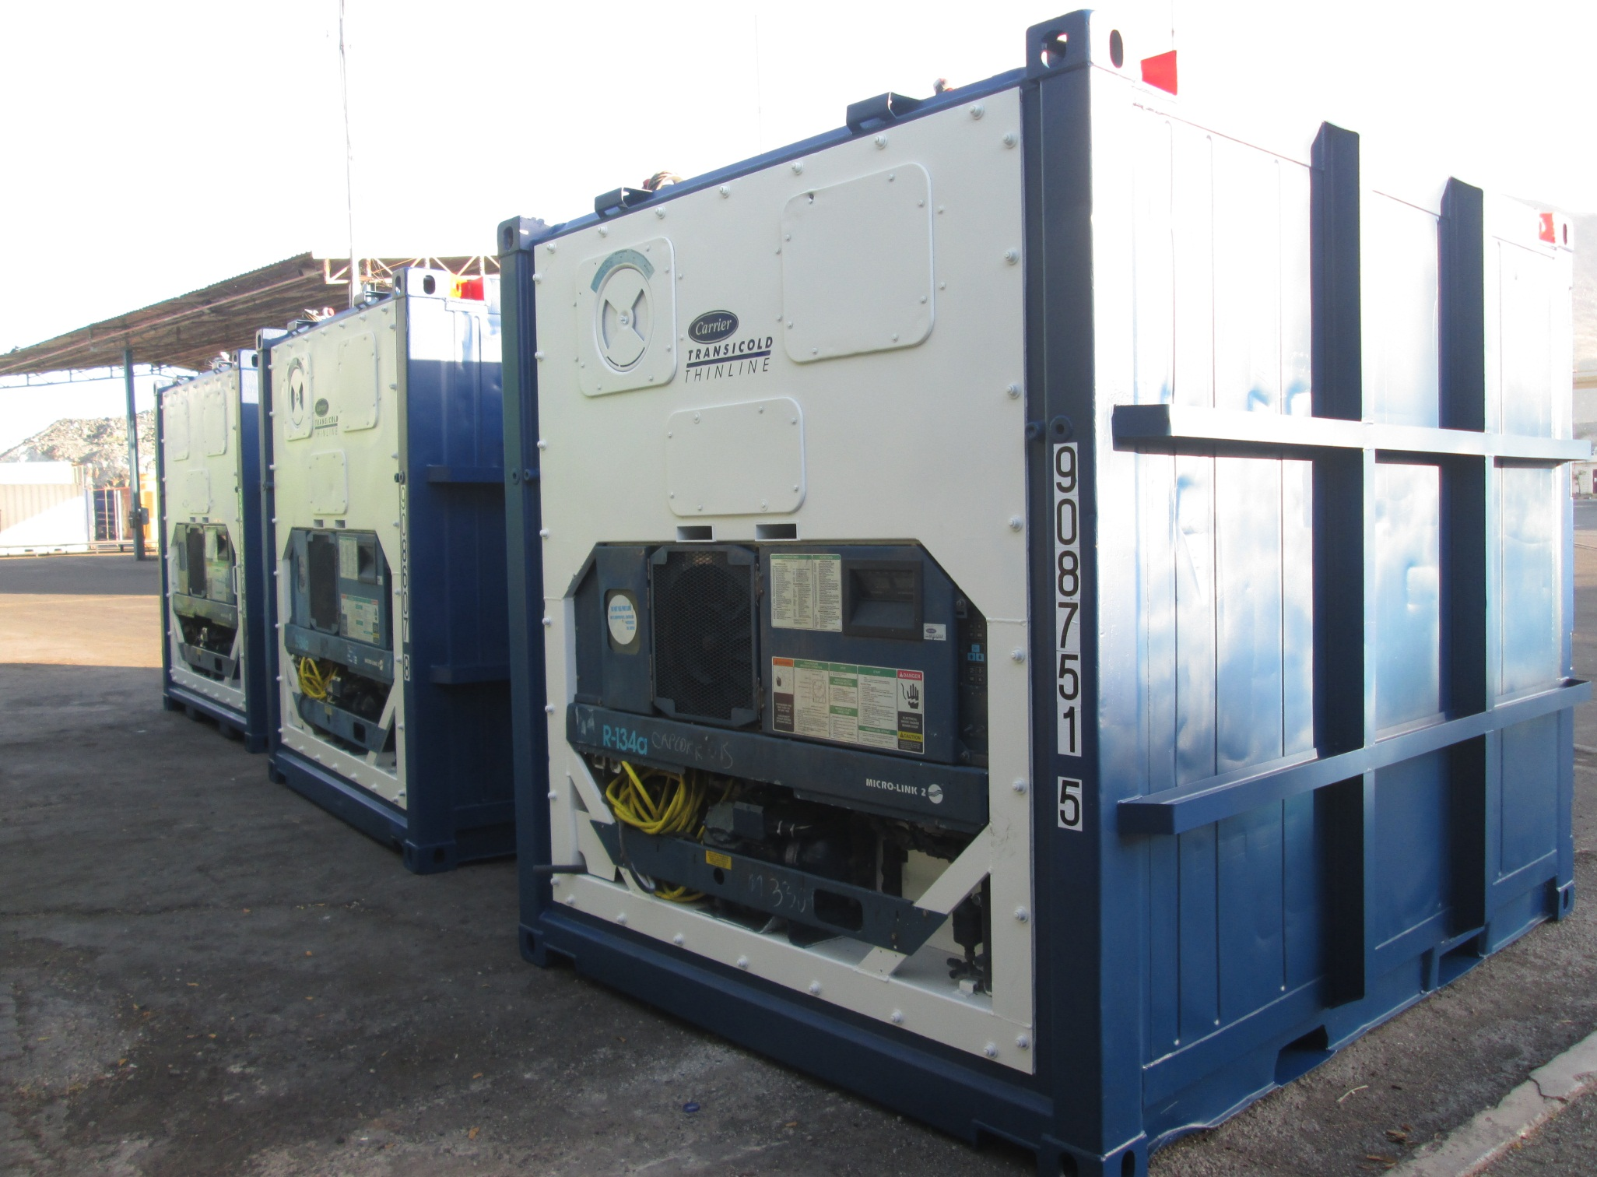
10’REEFERS FOR ADMA/ZADCO/DP STANDARD
10FT X 8FT X 8FT 6 INCH HIGH
CORTEN STEEL BODY
ISO CASTING
PADEYE FOR LIFTING WITH SLING/SHACKLES
Leaders Containers Trading FZE

Slide 7
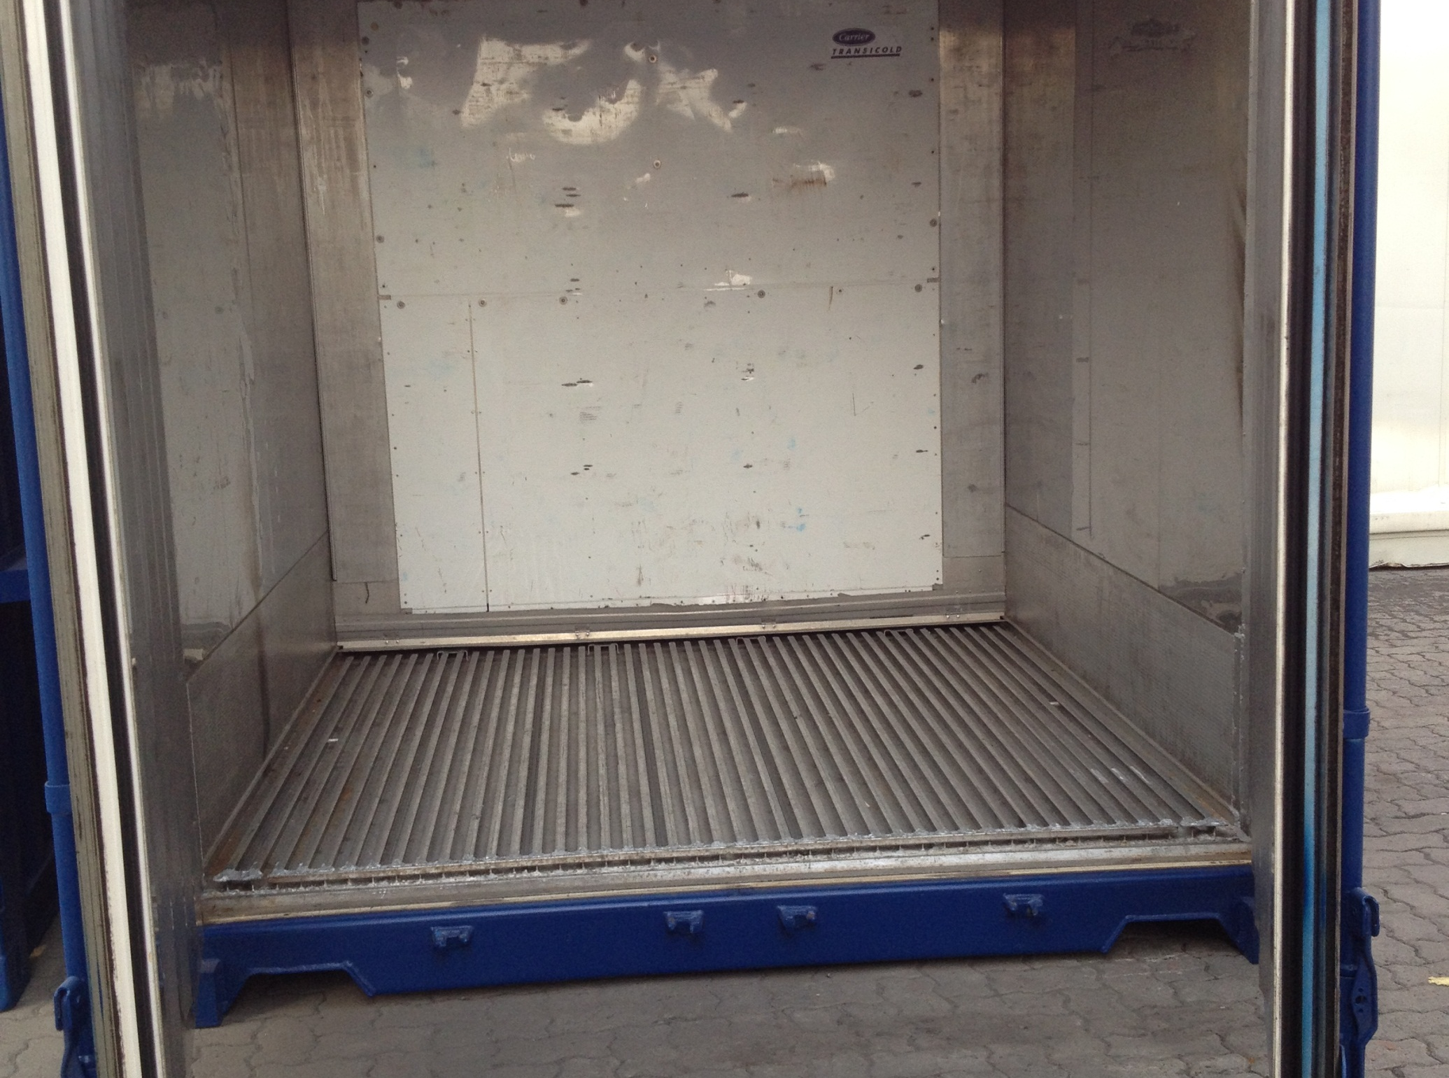
SS REEFER BODY INTERIOR
ALUMINIUM T FLOORING
Leaders Containers Trading FZE

Slide 8
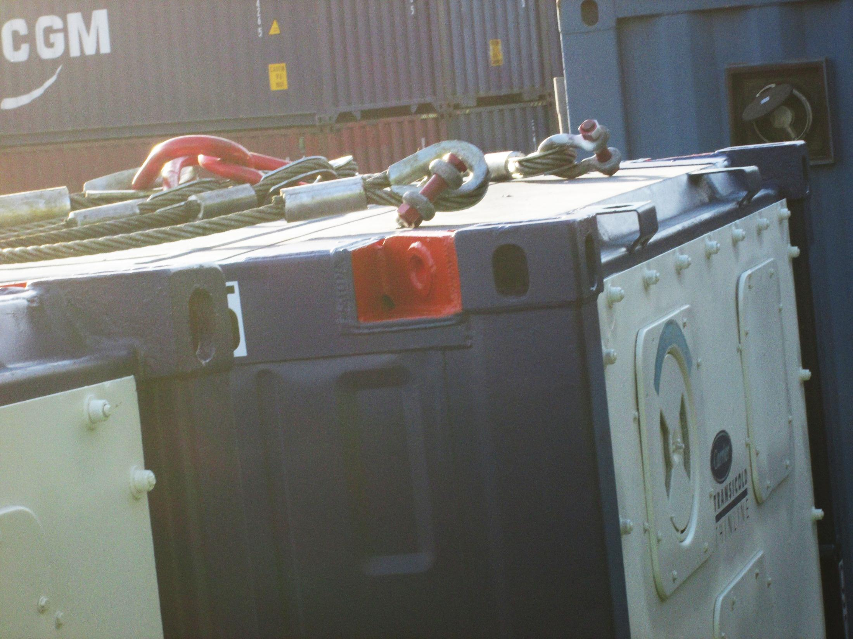
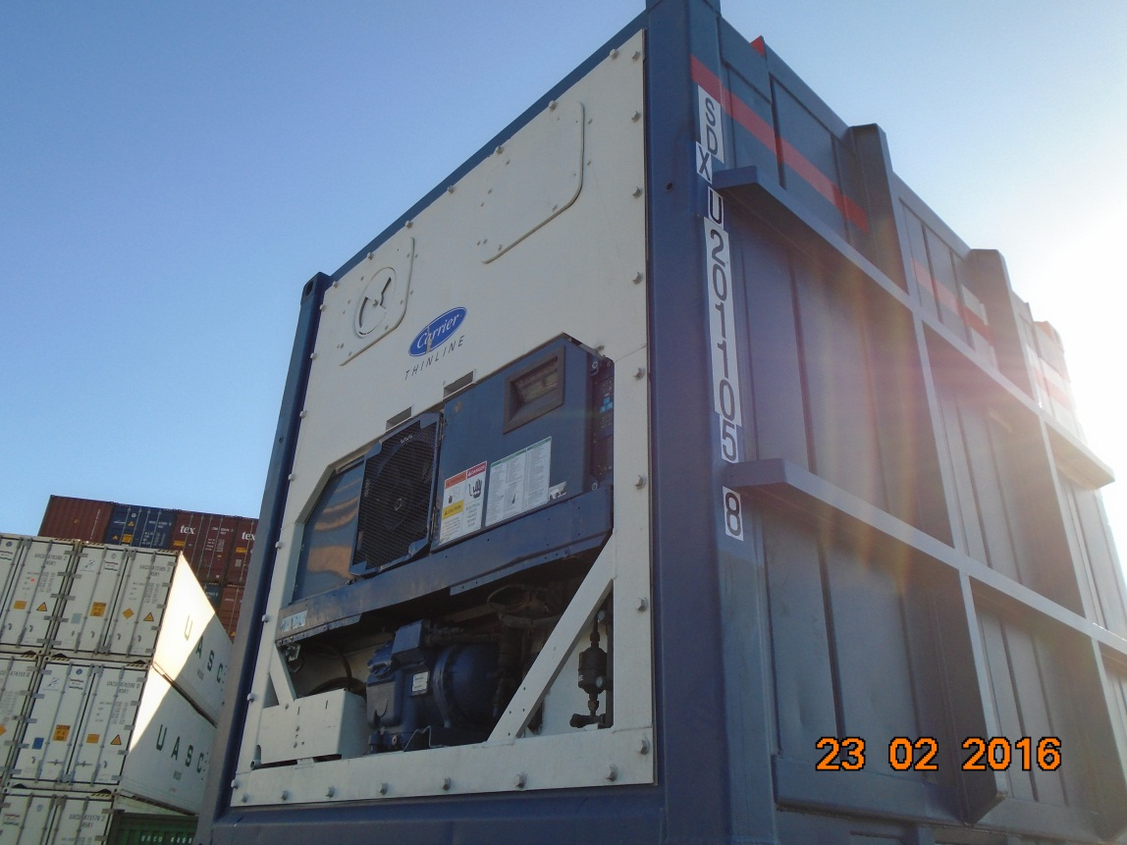
PAD EYE MEASUREMENT
SIZE:- 200mm X 110 mm
THICKNESS:- 25 mm
HOLE SIZE:- 37mm
PAD EYE BASE PLATE:- 250X250X14mm
SIDE PLATE:-250X110X14mm
PAD EYE WITHOUT REMOVING ISO CASTING FOR DUAL PURPOSE-SHIPPING&OFF SHORE
CERTIFIED SLING/SHACKLES
THIRD PARTY LIFTING CERTIFICATION APPROVED BY OFFSHORE SURVEYORS
MPI OR DP TEST ON PAD EYE
PRE-TRIP INSPECTION ON MACHINERY
Leaders Containers Trading FZE

Slide 9
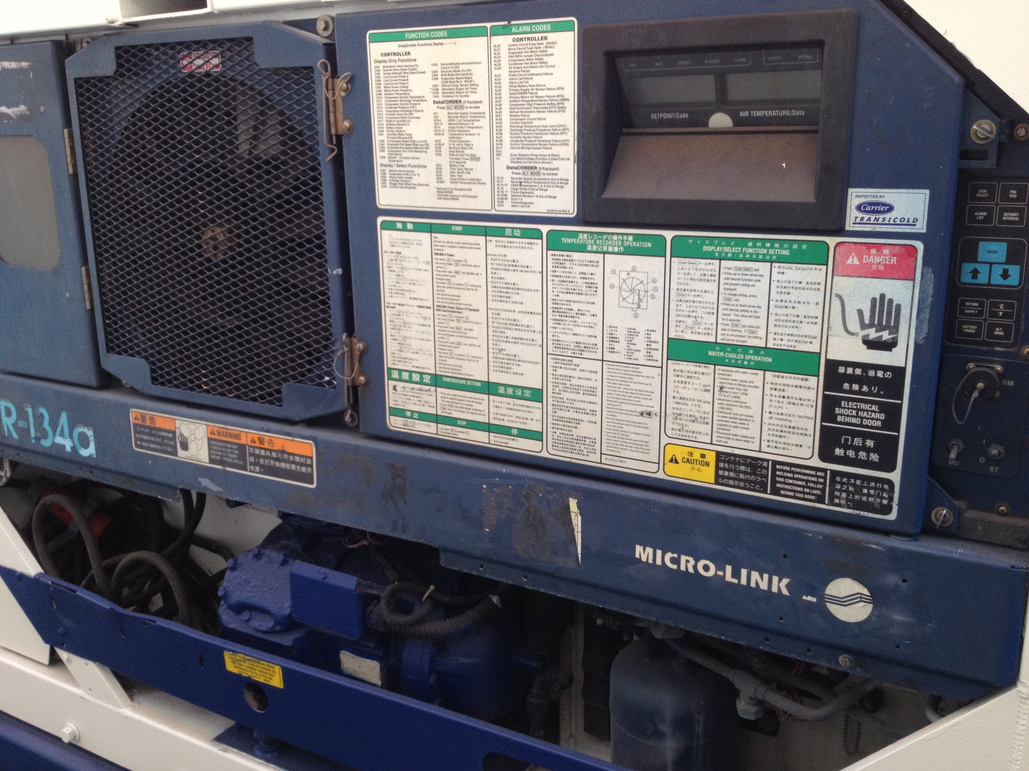
MACHINERY DETAILS
R134A SYSTEM
VOLTAGE=380V TO 440V
50/60 HTZ
3 PHASE CURRENT
4 CORE WIRE
4 PIN PLUG
MAXIMUM TEMPERATURE MAINTAINING -30 ⁰C
Leaders Containers Trading FZE

Slide 10
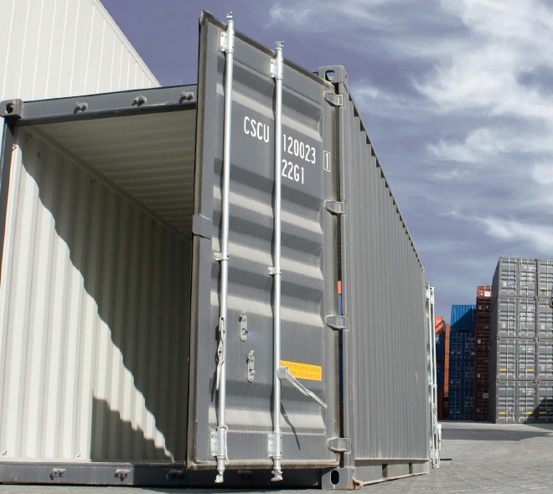
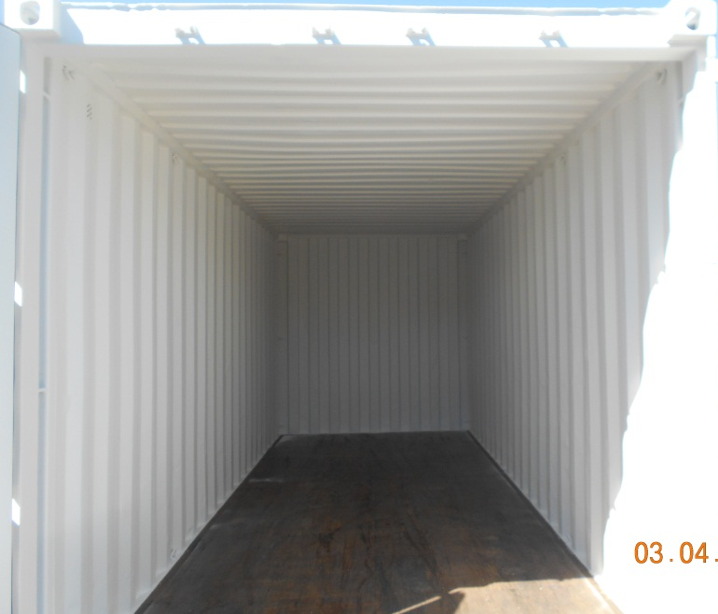
EXTERNAL CONTAINER DIMENSION | 20’ STANDARD CONTAINER
CONTAINER LENGTH | 6.06 m
CONTAINER WIDTH | 2.44 m
CONTAINER HEIGHT | 2.59 m
INTERNAL CONTAINER DIMENSION | 20’ STANDARD CONTAINER
CONTAINER LENGTH | 5.87 m
CONTAINER WIDTH | 2.33 m
CONTAINER HEIGHT | 2.35 m
Leaders Containers Trading FZE

Slide 11
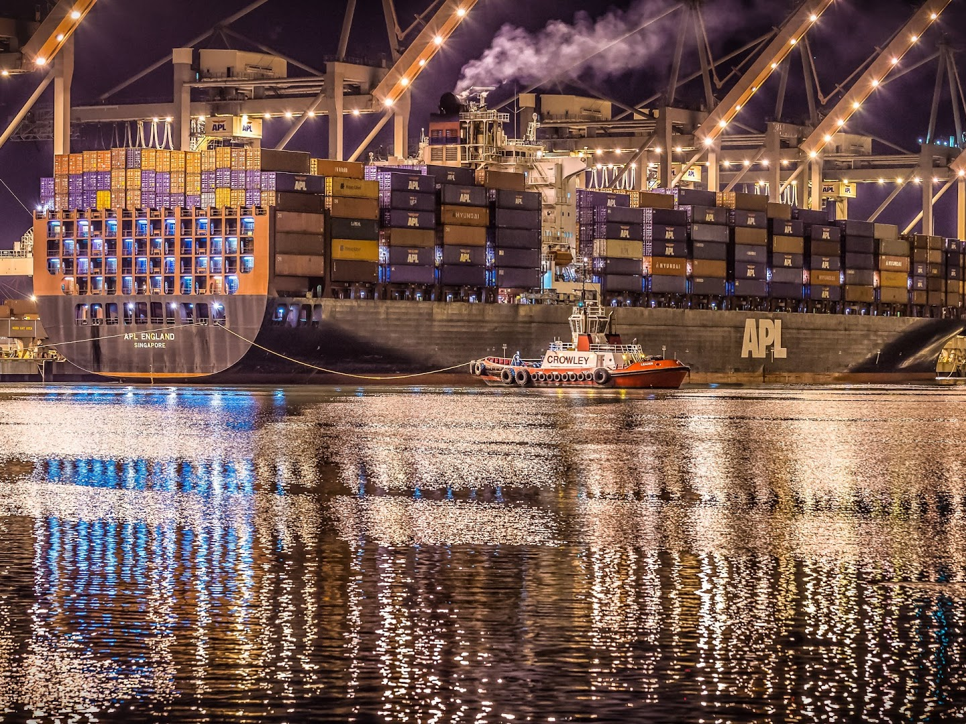
THANKYOU
Leaders Containers Trading FZE
P.O.Box 54463, Dubai, U. A. E.
Email: sales@leaderscontainers.com
Web: www.leaderscontainers.com

